Slide 1
Chapter 7
Arrays in Python

Slide 2
List of contents
Introduction to arrays
Advantages of arrays
Creating an array
Importing the array module
Indexing and slicing on array
Processing the arrays
Types of arrays
Working with arrays using numpy
Creating arrays in different ways
Mathematical operations on arrays
Comparing arrays
Aliasing the arrays
Viewing and copying arrays
Slicing and indexing in numpy Arrays
Dimensions of arrays
Attributes of an array
The reshape() method
The flatten() method
Working with multi-dimensional arrays

Slide 3
List of contents (continuation….)
Indexing in multi-dimensional arrays
Slicing the multi-dimensional arrays
Matrices in numpy
Getting Diagonal elements of a Matrix
Finding maximum and minimum elements
Finding sum and average of elements
Product of elements
Sorting the matrix
Transpose of a matrix
Matrix addition and multiplication
Random numbers

Slide 4
Introduction to arrays
Array is an object that stores a group of elements of same datatype
The main advantage of any array is to store and process a group of elements easily
We should remember 2 points about array in python
Arrays can store only one type of data
Arrays can increase of decrease their size dynamically
Array in python is a standard module named ‘array’, it helps us to deal with arrays in python
>>> help()
help>array

Slide 5
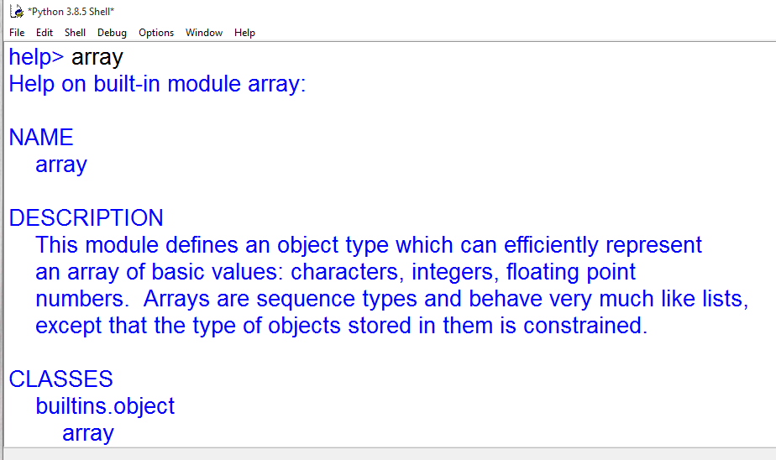
You will get information about array

Slide 6
Advantages of arrays
Arrays are similar to list. The main difference is that arrays can store only one type of elements, where as list can store different types of elements
The size of the array is not fixed in python
Array can grow and shrink in memory dynamically
Arrays are useful to handle a collection of elements like a group of numbers of characters
Methods that are useful to process the elements of any array are available in ‘array’ module

Slide 7
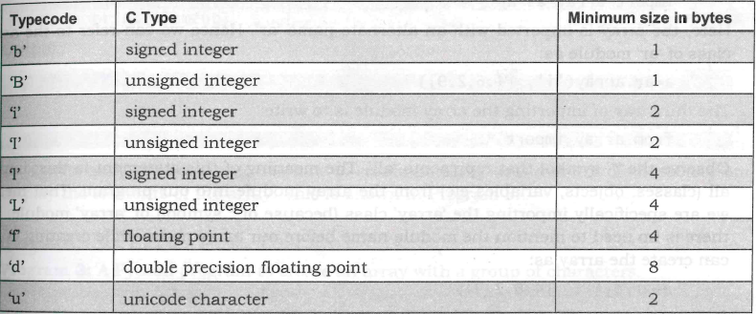
Creating an array
Type should be specified by using a type code at the time of creating the array object
Syntax:
arrayname=array(type code, [elements])
The type codes to create arrays

Slide 8
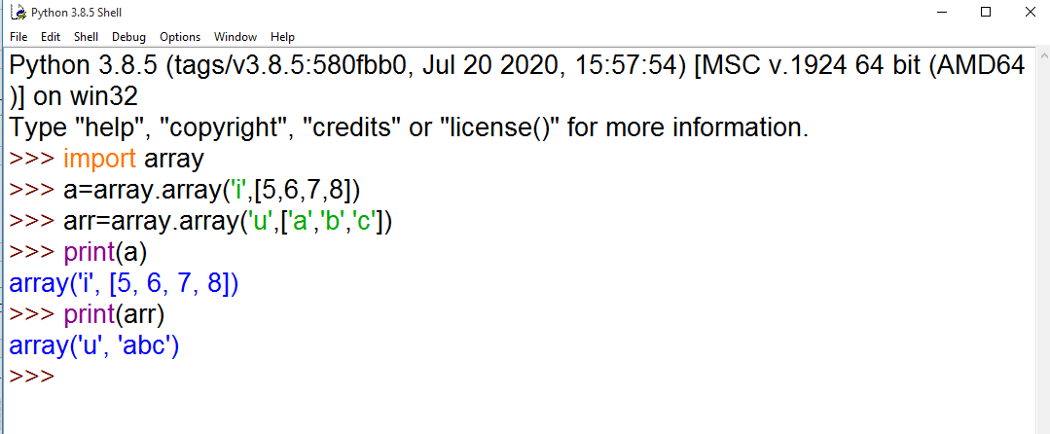
Example:

Slide 9
Importing the array module
There are three ways to import array module
import array
import array as ar
from array import *
An array can also be created from another array
Go to Jupyter notebook for examples

Slide 10
Indexing and slicing on array
An index represents the position number of an element in an array
A slicing represents a piece of array.
When we perform slicing operations on an array, we can retrieve a piece of the array that contains a group of elements.
Syntax for slicing
arrayname[start:stop:stride] # Here stride represents step size
Go to Jupyter notebook for examples

Slide 11
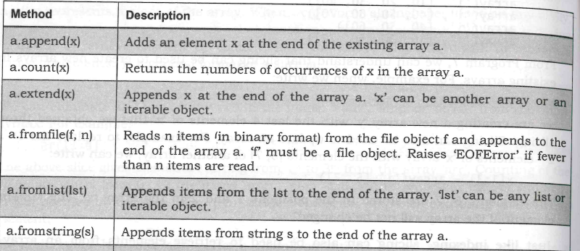
Processing the arrays
The array class in array module offers methods to process the array easily
Array methods where listed below

Slide 12
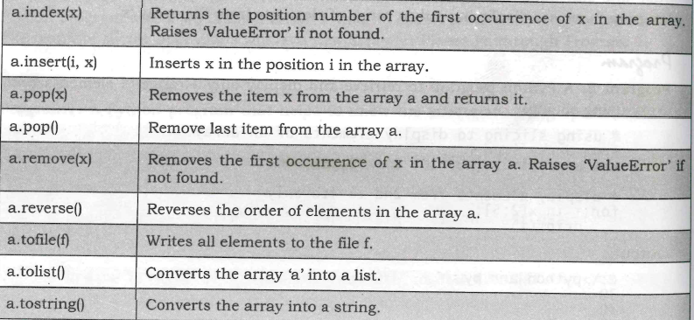

Slide 13
Variables of array class
Methods and variables are called by using its object
objectname.method()
objectname.varable
Go to Jupyter notebook for examples
Variable | Description
a.typecode | Represents the type code character used to create the array a
a.itemsize | Represents the size of items stored in the array (in bytes)

Slide 14
Types of arrays
In any programming language like C or Java offers two types of arrays.
They are
Single dimensional array
Multi-dimensional array
marks=array([[50,60,70,66,72],
[60,62,71,56,70],
[55,59,80,68,65]])
Here we have 3 single dimensional arrays with 5 elements in each
Python does not support multi-dimensional arrays. But that is not a bad news.
We can construct multidimensional arrays using third party packages like numpy (numerical python).

Slide 15
Working with arrays using numpy
numpy is a package that contains several classes, functions, variables etc. to deal with scientific calculations in Python
In addition, numpy contains a large library of mathematical functions like linear algebra functions and Fourier transforms. To get complete help on numpy, the reader can refer to the following link at scipy.org. http://docs.scipy.org/doc/numpy/reference/
The arrays which are created using numpy are called n dimensional arrays where n can be any integer. If n=1, it represents a one dimensional array. If n=2, it is a two dimensional array.
Importing numpy module can be done in 3 ways as we did in array module
Go to Jupyter notebook for examples

Slide 16
Creating arrays in numpy can be done in several ways. Some of the important ways are:
Using array() function
Using linspace0 function
Using logspace() function
Using arange() function
Using zeros() and ones() functions

Slide 17
Creating arrays using array() function
We can call array() function of numpy module to create an array.
When we create array, we can specify the datatype of the elements either as ‘int’ or ‘float’
Examples:
arr1 = array([10, 20, 30, 40, 50], int)
arr2 = array([1.5, 2.5, 3, 4, -5.1], float)
In the array, if Python interpreter finds one element belts to 'float type', then it will convert all the other elements also into float type
To create an array with character type elements, we need not specify the datatype. We can simply write:
arr3 = array(['a', 'b', 'c', 'd'])

Slide 18
To create a string type array where can store a group of strings, we should use additional attribute 'dtype = str' in the array() function as:
arr = array([' Delhi', 'Hyderabad', 'Mumbai', 'Ahmedabad'], dtype=str)
Alternately, we can omit the 'dtype=str' in the above statement and write it as:
arr = array ([ 'Delhi', ' Hyderabad ' , ‘Mumbai', 'Ahmedabad'])
Creating arrays using linspace() function
The linspace() function is used to create an array with evenly spaced points between a starting point and ending point.
The form of the linspace() function is:
linspace (start,stop,n)
Here n is is an integer that represents the number of parts the elements should be divided.

Slide 19
Let's take one example to understand this.
a = linspace(0, 10, 5)
In the above statement, we are creating an array 'a' with starting element 0 and ending element 10.
This range is divided into 5 equal parts and hence the points will be 0, 2.5, 5, 7.5 and 10.
Creating array using logspace() function
The logspace() function is similar to linspace(). The linspace() function produces th_{e} evenly spaced points. Similarly, logspace() produces evenly spaced points on a logarithmically spaced scale.
The logspace() function is used in the following format:
logspace(start, stop, n)

Slide 20
The logspace() function starts at a value which is 10 to the power of 'start' and ends at value which is 10 to the power of `stop'
If ‘n’ is not specified, then its value is taken as 50
For example, if we write:
a = logspace(1, 4, 5)
This function represents values starting from 10¹ to 10⁴.
These values are divided into 5 equal points and those points are stored into the array `a'

Slide 21
Creating arrays using arange() function
The arange() function in numpy is same as range() function in Python.
The arange() function is used in the following format:
arange (start , stop, stepsize)
This creates an array with a group of elements from 'start' to one element prior to ‘stop' in steps of 'stepsize'
If the 'stepsize' is omitted, then it is taken as 1
If the 'start' is omitted, then it is taken as 0

Slide 22
Examples:
arange (10) # will produce an array with elements 0 to 9.
arange(5, 10) # will produce an array with elements from 5 to 9.
arange(1, 10, 3) # will produce an array with elements 1,4, and 7.
arange(10, 1, -1) # Since the stepsize is -1, it represents the elements in descending order from 10 to 2, as: , [10 9 8 7 6 5 4 3 2 ]
arange(0, 10, 1.5) # In this case, the array elements will be: [0. 1.5 3. 4.5 6. 7.5 9.]

Slide 23
Creating arrays using zeros() and ones() functions
We can use the zeros() function to create an array with all zeros.
The ones() function useful to create an array with all 1s.
They are written in the following format:
zeros(n , datatype)
ones(n , datatype)
Examples:
zeros (5)
This will create an array with 5 elements all are zeros, as: [ 0. 0. 0. 0. 0 ].
If want this array in integer format, we can use 'int' as datatype, as:
zeros(5, int)
this will create an array as: [ 0 0 0 0 0 ].

Slide 24
If we use ones() function, it will create an array with all elements 1.
For example,
ones(5, float)
will create an array with 5 integer elements all are is as: [ 1. 1. I. 1. 1. ]

Slide 25
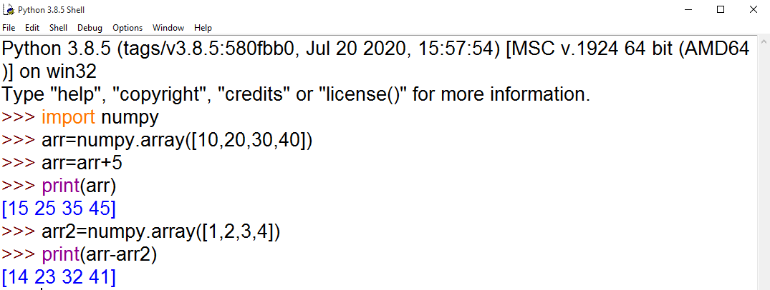
Mathematical operations on arrays
It is possible to perform various mathematical operations like addition, subtraction, division, etc. on the elements of an array.
Also, the functions of 'math' module can be applied to the elements of the array.
For example:

Slide 26
Similarly, to divide one array 'a' with another array ‘b’, we can write a/b.
These kinds of operations are called vectorized operations, since the entire array (or vector) is processed just like a variable.
Vectorized rations are important because of two reasons:
Vectorized operations are faster. Adding two arrays in the form of a+b is much faster than taking the corresponding elements of both the arrays and then adding them.
Vectorized operations are syntactically clearer. To add two arrays, we can simply write a+b. This is clearer than using loops and iterating through all the elements of the arrays while adding them.
Vectorized operations provide compact code.
We can apply mathematical functions like sin(), cos(), sqrt(), exp(), abs(), etc. on the elements of the array.
All these functions are re-defined in numpy module.

Slide 27
Function | Meaning
sin(arr) | Calculates sine value of each element in the array 'err'.
cos(arr) | Calculates cosine value of each element in the array 'arr.
tan(arr) | Calculates tangent value of each element in the array 'arr'.
arcsin(arr) | Calculates sine inverse value of each element in the array 'ars'.
arcos(arr) | Calculates cosine inverse value of each element in the array 'arr'.
arctan)arr) | Calculates tangent inverse value of each element in the array 'arr'.
Log(err) | Calculates natural logarithmic value of each element in the array 'err'.
abs(arr) | Calculates absolute value of each element in the array 'ars'.
sqrt(arr) | Calculates square root value of each element in the array 'are.
power(arr, n) | Returns power value of each element in the array 'ars' when raised to the power of 'n'.

Slide 28
exp(arr) | Calculates exponentiation value of each element in the array 'arr'.
sum(arr) | Returns sum of all the elements in the array 'arr'.
prod(arr) | Returns product of all the elements in the array 'arr'.
min(arr) | Returns smallest element in the array `arr'.
max(arr) | Returns biggest element in the array 'arr'.
mean(arr) | Returns mean value (average) of all elements in the array 'arr'.
median(arr) | Returns median value of all elements in the array 'arr'.
var(arr) | Returns variance of all elements in the array 'arr'.
cov(arr) | Returns covariance of all elements in the array 'arr'.
std(arr) | Gives standard deviation of elements in the array 'are.
argmin(arr) | Gives index of the smallest element in the array. Counting starts from,' 0.

Slide 29
argmax(arr) | Gives index of the biggest element in the array. Counting starts from 0.
unique(arr) | Gives an array that contains unique elements of the array 'arr'.
sort(arr) | Gives an array with sorted elements of the array 'arr' in ascending order.
Concatenation([a,b]) | Returns an array after joining a, b arrays. The arrays a, b should be entered as elements of a list.
Go to Jupyter notebook for examples

Slide 30
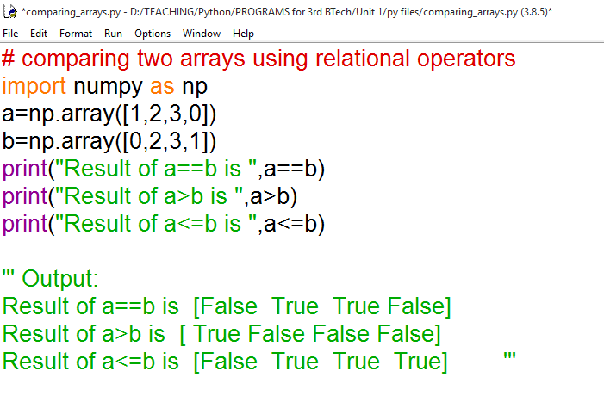
Comparing arrays
We can use the relational operators ( >, >=, <, <= and != ) to compare the arrays of same size
This will return another array with Boolean values.(True or False)
Example:

Slide 31
The any() and all() functions return either True or False
The any() function can be used to determine if any one element of the array is True.
The all() function can be used to determine whether all the elements in the array are True.
The functions logical_and(), logical_or() and logical_not() are useful to get the Boolean array as a result of competing the compound condition
The where() function is used to create a new array based on whether a given condition is True or False
Syntax: array=where(condition, expression1, expression2)
If the ‘condition’ is true, expression1 is executed and the result is stored into the array, else expression2 is executed and the result is stored into the array
The nonzero() function is useful to know the positions of elements which are non zero. This function returns an array that contains the indexes of the elements which are non zero.
Go to Jupyter notebook for examples

Slide 32
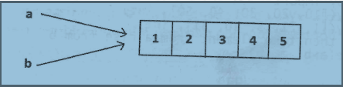
Aliasing the arrays
Aliasing means giving another name to the existing object
Aliasing is not copying
Any modifications to the alias object will reflect in the existing object and vice versa
Assignment operator is used to do aliasing
For example: a=b
Go to Jupyter notebook for examples

Slide 33
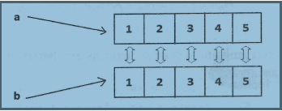
Viewing and copying arrays
We can create another array that is same as an existing array by using view() method.
The original array and the newly created arrays will share different memory locations.
If the newly created array is modified, the original array will also be modified since the elements in the both arrays will be like mirror images
This is also called as ‘shallow copying’

Slide 34
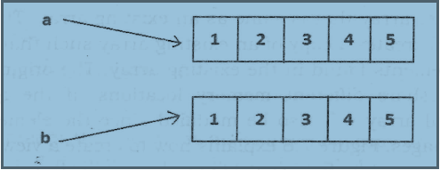
Suppose we want both the arrays to be independent and modifying one array should not affect another array, we should go for ‘deep copying’
This is done with the help of copy() method
Go to Jupyter notebook for examples

Slide 35
Slicing and indexing in numpy Arrays
It is same like we did for normal array or list or string etc.
Slicing refers to extracting a range of elements from the array
The format of slicing operation is given here:
arrayname[start:stop:stepsize]
The default value for ‘start’ is 0, ‘stop’ is number of elements and ‘stepsize’ is 1
Go to Jupyter notebook for examples

Slide 36
Dimensions of arrays
The dimensions of array represents the arrangements of elements in the array.
If the elements are arranged horizontally, it is called a row and if the elements are arranged vertically, then it is called a column
An array with one row and one column is called 1D array or single dimension array
An array that contains more than 1 row and 1 column is called 2D array
A three-dimensional (3D) array is composed of 3 nested levels of arrays, one for each dimension.
And so on…
Go to Jupyter notebook for examples

Slide 37
Attributes of an array
Numpy's array class is called ndarray. It is also known by alias name array.
This class contains the following important attributes or variables
The ndim Attribute
The shape Attribute
The size Attribute
The itemsize Attribute
The dtype Attribute
The nbytes Attribute

Slide 38
The ndim Attribute:
The `ndim' attribute represents the number of dimensions or axes of the array. The number of dimensions is also referred to as 'rank'. For a single dimensional array, it is 1 and for a two dimensional array, it is 2 and so on.
The shape Attribute:
The 'shape' attribute gives the shape of an array. The shape is a tuple listing the number of elements along each dimension. A dimension is called an axis. For a 1D array, shape gives the number of elements in the row. For a 2D array, it specifies the number of rove and columns in each row. We can also change the shape using 'shape' attribute
The size Attribute:
The 'size' attribute gives the total number of elements in the array

Slide 39
The itemsize Attribute:
The itemsize attribute gives the memory size of the array element in bytes.
The dtype Attribute:
The ‘dtype‘ attribute gives the datatype of the elements in the array.
The nbytes Attribute:
The 'nbytes' attribute gives the total number of bytes occupied by an array
Go to Jupyter notebook for examples

Slide 40
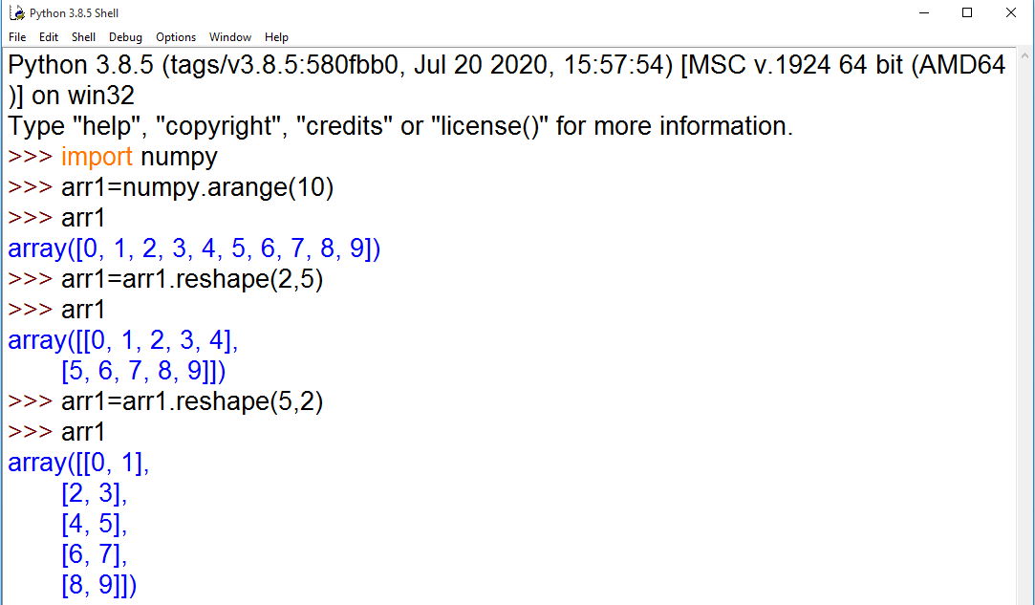
The reshape() method
The 'reshape()' method is useful to change the shape of an array. The new array should have the same number of elements as in the original array

Slide 41
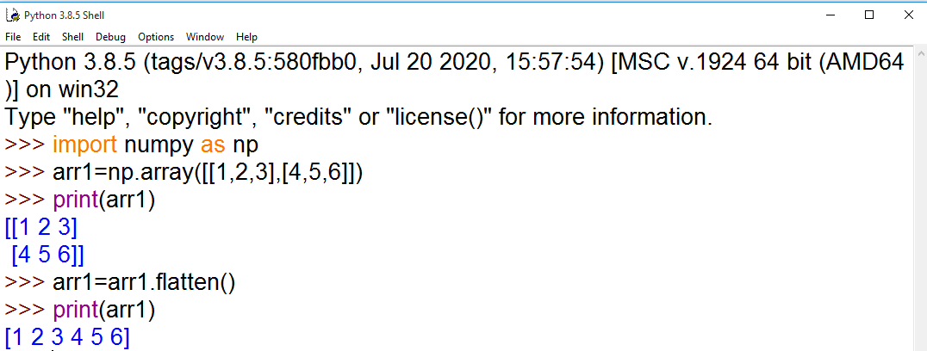
The flatten() method
The flatten() method is useful to return a copy of the array collapsed into one dimension

Slide 42
Working with multi-dimensional arrays
The 2D arrays, 3D arrays etc. are called multi-dimensional arrays.
A 2D array contains more than 1 row and 1 column and it can be treated as a combination of several ID arrays. A 2D array is also considered as a matrix.
For example, a 2D array with `m' rows and ‘n’ columns is called m x n matrix.
We can create multi-dimensional arrays in the following ways:
Using array() function
Using ones() and zeroes() functions
Using eye() function
Using reshape() function

Slide 43
Using array() function
Numpy's array() function can be used to create a multidimensional array.
Usually, we pass lists of elements to this function. If we pass one list of elements to this function, then it will create a 1D array. If we pass two lists of elements, then this function creates a 2D array
Using ones() and zeroes() functions
The ones() function is useful to create a 2D array with several rows and columns where all the elements will be taken as 1. The format of this function is:
ones((r, c), dtype)
Here, ‘r’ represents the number of rows and 'c' represents the number of columns. 'dtype' represents the datatype of the elements in the array
the zeros() function is useful to create a 2D array with elements filled with zeros. The format of this function is:
zeros((r, c), dtype)

Slide 44
Using eye() function
The eye() function creates a 2D array and fills the elements in the diagonal with digit 1.
The general format of using this function is:
eye(n, dtype=datatype)
This will create an array with n' rows and ‘n’ columns.
The default datatype is 'float'
Using reshape() function
This function is useful to convert a ID array into a multidimensional (2D or 3D) array. The syntax of writing this function is:
reshape(arrayname, (n, r, c))
Here, 'arrayname' represents the name of the array whose elements to be converted. 'n' indicates the number of arrays in the resultant array. 'r' , indicates the number of rows and columns, respectively.
Go to Jupyter notebook for examples

Slide 45
Indexing in multi-dimensional arrays
Index represents the location number.
The individual elements of a 2D array can be accessed by specifying the location number of the row and column of the element
For example:
a[0][0] # represents 00 row and 00 column element in the array 'a'
b[1][3] # represents in row and 3rd column element in the array 'b‘
Go to Jupyter notebook for examples

Slide 46
Slicing the multi-dimensional arrays
A slice represents a part or piece of the array.
In the previous sections, we already discussed about slicing in case of single dimensional arrays.
Now, we will see how to do slicing in case of multi-dimensional arrays, especially in 2D arrays.
The format of slice operator is:
arrayname [start : stop: stepsize]
The default value for 'start' is 0, for 'stop' is n (n is number of elements) and for 'stepsize' is 1.

Slide 47
Any of the following statement displays entire 2D array
a[ : , : ]
a[ : ]
a[ : : ]
Go to Jupyter notebook for examples

Slide 48
Matrices in numpy
In Mathematics, a matrix represents a rectangular array of elements arranged in rows and columns.
It means elements are available in a matrix in the form of several rows and columns.
If a matrix has only 1 row, it is called a 'row matrix'. If a matrix has only 1 column, then it is called a 'column matrix'.
We can understand that the row matrix and column matrices are nothing but 1D arrays.
When a matrix has more than 1 row and more than 1 column, it is called m x n matrix where it represents the rows and n represents the columns.
Thus, a 2 x 3 matrix , contains 2 rows and 3 columns. We can show these matrices using numpy 2D arrays.
To work with matrices, numpy provides a special object called matrix. In numpy, a matrix is a specialized 2D array that retains its 2D nature through operations.

Slide 49
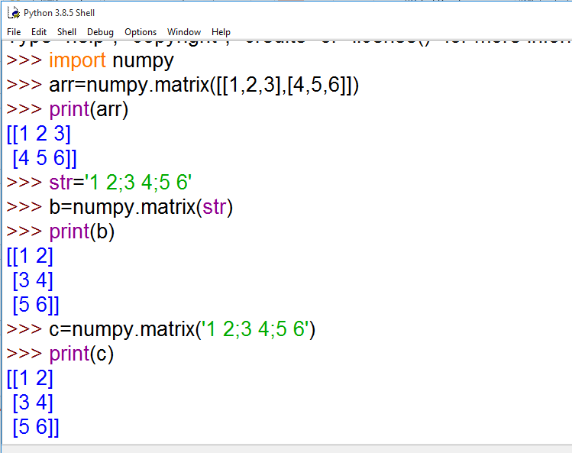
we can create numpy matrices using the following syntax:
matrix-name = matrix(2D array or string)
It means, the matrix object receives a 2D array or a string that contains elements which can be converted into a matrix.
For example

Slide 50
Getting Diagonal elements of a Matrix
To retrieve the diagonal elements of a matrix, we can use diagonal() function as:
a = diagonal(matrix)
The diagonal function returns a 1D array that contains diagonal elements of the original matrix.
Finding maximum and minimum elements
To know the maximum element, we can use max() method and to know the minimum element, we can use min() methods.
Finding sum and average of elements
To find sum of all the elements in the matrix, we can use sum() method and to find average, we can use mean() method.

Slide 51
Product of elements
It is possible to know the products of elements in a matrix. For this purpose, numpy provides prod() method.
For example, prod(0) returns a matrix that contains the products of elements in each column of the original matrix.
prod(1) returns a matrix that contains products of elements in each row.
Sorting the matrix
numpy provides sort() function that sorts the matrix elements into ascending order. See the syntax of this function:
sort(matrix_name, axis)
If we use, axis=l, it sorts the elements in each row into ascending order.
If we use, axis=0, then it sorts the elements in each column into ascending order.
The default value of axis is 1. It means, if we do not mention 'axis', then its value will be taken as 1

Slide 52
Transpose of a matrix
Rewriting matrix rows into columns and vice versa is called 'transpose'. Thus, the rows in the original matrix will become columns in the transpose matrix and the columns in the original matrix will become rows in the transpose matrix. It means if the original matrix has m x n size, the transpose matrix will have n x m size. To find the transpose
we can use transpose() and getT() methods in numpy.
Matrix addition and multiplication
We can use arithmetic operators like +, - and / to perform addition, subtraction and division operations on 2 matrices
Go to Jupyter notebook for examples

Slide 53
Random numbers
A random number is a number that cannot be guessed by anyone.
When a random number is generated, we do not know which number we are going to get.
numpy has a sub module called random that is equipped with the rand() function that is useful to create random numbers.
To call this function, we should use: random.rand() since it belongs to the 'random' sub module.
When we simply call the rand() function, it will generate a random number between 0.0 and 1.0
Go to Jupyter notebook for examples

